Slide 1

Movie Recommendation System
Final Project for Survey Of Machine Learning
Rajat Srivastava
Prakhar Goyal
Sidharth Gaur

Slide 2

Problem Statement & Business Value

Slide 3
How to recommend movies to a user based on the preferences of similar users?

Slide 4



Why invest in building a recommendation system
Improve customer retention
Increase revenues
Form habits
Notes:
Retention: Continuously catering to users’ preferences makes them more likely to remain loyal subscribers to the service
Revenues: Various research shows an increase in upselling revenue ranging from 10-50% caused by accurate “You might also like” product recommendations
Habits: Serving accurate content can trigger cues, building strong habits and influencing usage patterns in customers

Slide 5
About the dataset

Slide 6



Overview of the dataset
Dataset consists of movies released on or before July 2017
Dataset also has files containing 26 million ratings from 270,000 users for all 45,000 movies
Data points include cast, crew, plot keywords, budget, revenue and other details

Slide 7
Methodology

Slide 8
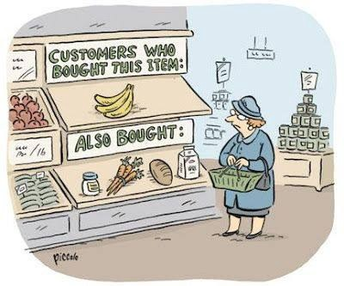
Collaborative filtering
A technique that can filter out items that a user might like based on the reactions by similar users

Slide 9
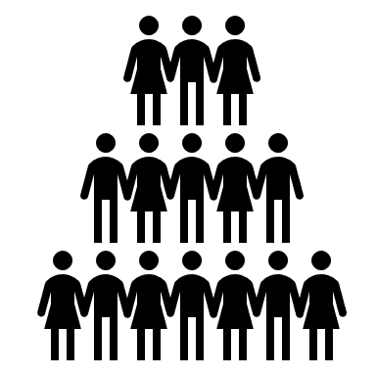



Collaborative filtering - Introduction
Find a smaller set with tastes similar to a specific user
Look at the items they like and create a ranked list
Search a large group of users
Notes:
It works by searching a large group of people and finding a smaller set of users with tastes similar to a particular user. It looks at the items they like and combines them to create a ranked list of suggestions. There are many ways to decide which users are similar and combine their choices to create a list of recommendations

Slide 10
Our Model

Slide 11

Project lifecycle
Data ingestion & processing
Model Development
Model Evaluation
Convert data into a form suitable for modeling
Develop a model suited for the business problem
Evaluate effectiveness of the developed model

Slide 12
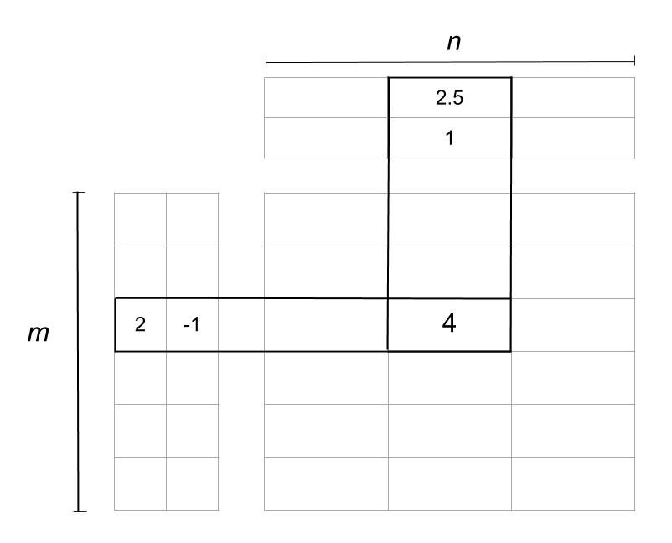
Model Details
Since, we have a sparse user-rating matrix, first step is to reduce the matrix dimension
We have used the Low Rank Matrix Factorization using Least Squares Method algorithm
For example in the image above, the matrix is reduced into two matrices. The one on the left is the user matrix with m users, and the one on top is the item matrix with n items. The rating 4 is reduced or factorized into:
A user vector (2, -1)
An item vector (2.5, 1)

Slide 13
Results and Conclusions

Slide 14
Interpreting model results
Our model provides an estimate of the rating that a user will provide to a movie that he has not seen yet
We sort these ratings in descending order and pick the first K movies to recommend to this user, where K is the number of movies we want to recommend.
original_title | genres
Sleepers | [{'id': 80, 'name': 'Crime'}, {'id': 18, 'name': 'Drama'}, {'id': 53, 'name': 'Thriller'}]
Nuovo Cinema Paradiso | [{'id': 18, 'name': 'Drama'}, {'id': 10749, 'name': 'Romance'}]
The French Connection | [{'id': 28, 'name': 'Action'}, {'id': 80, 'name': 'Crime'}, {'id': 53, 'name': 'Thriller'}]
original_title | genres
Pulp Fiction | [{'id': 53, 'name': 'Thriller'}, {'id': 80, 'name': 'Crime'}]
The Shawshank Redemption | [{'id': 18, 'name': 'Drama'}, {'id': 80, 'name': 'Crime'}]
Schindler's List | [{'id': 18, 'name': 'Drama'}, {'id': 36, 'name': 'History'}, {'id': 10752, 'name': 'War'}]
Collaborative Filtering Model
Top rated movies
Recommended movies

Slide 15

Thank You

